Slide 1
Academic Calendar and Fee Schedule
NOTE – CENSUS DATES – apply to Students who are paying their fees using VET STUDENT LOANS
2024 TERM DATES | CENSUS DATE | 2025 TERM DATES | CENSUS DATE | 2026 TERM DATES | CENSUS DATE | 2027 TERM DATES | CENSUS DATE
08 Jan2024 – 15 Mar2024 | 22 Jan 24 | 13 Jan2025 – 22 Mar2025 | 28 Jan 25 | 12 Jan 2026 – 20 Mar 2026 | 25 Jan 26 | 11 Jan 2027 – 19 Mar 2027 | 24 Jan 27
08 Apr2024 – 14 Jun2024 | 22 Apr 24 | 14 Apr2025 – 21 Jun2025 | 28 Apr 25 | 13 Apr 2026 – 19 June 2026 | 26 Apr 26 | 12 Apr 2027 – 18 June 2027 | 25 Apr 27
08 Jul2024 - 13 Sep2024 | 22 Jul 24 | 14 Jul2025 - 20 Sep2025 | 28 Jul 25 | 13 July 2026 – 18 Sept 2026 | 26 July 26 | 12 July 2027 – 17 Sept 2027 | 25 July 27
07 Oct2024 – 13 Dec2024 | 21 Oct 24 | 13 Oct2025 – 20 Dec2025 | 27 Oct 25 | 12 Oct 2026 – 18 Dec 2026 | 25 Oct 26 | 11 Oct 2027 – 17 Dec 2027 | 24 Oct 27
Holidays
Holidays breaks are scheduled between each term.
International students may only take a leave of absence outside of the scheduled breaks where there is a compassionate or compelling reason. Any unapproved leave of absence from the college during term will affect the Student Visa duration and in some cases result in a cancellation of a Student Visa. International students may apply to defer studies, however will need to provide sufficient authentic evidence to support their leave request on compassionate or compelling grounds.
2 April, 2024

Slide 2
Fee for Service Students
Fee Schedule
Course | Duration Months (Full time) | Terms (10 weekly blocks) | Campus | Tuition Fees AUD | Non-refundable Fees (AUD) |  |  |  | Funding Available
 |  |  |  |  | Enrolment Fee | Materials Fee | Text-Book Fees | Grayclay Weekly Payment Plan |  | Study Loan
 |  |  |  |  |  |  |  | Deposit | Est.Weekly Instalment
Graduate Diploma of Dermal Science 52854WA | 15 | 5 | Live Streamed | $17,412 |  |  | $ | $1500 | $306 (52) | 
Graduate Diploma of Cosmetic Nursing and Injectables 52852WA | 15 | 5 | Live Streamed | $21,156 |  |  | $ | $1500 | $378 (52) | 
Advanced Diploma of Cosmetic Dermal Science 52850WA | 15 | 5 | Live Streamed | $17,412 |  |  | $ | $1500 | $306 (52) | 
Diploma of Business BSB50120 | 12 | 4 | Supported Online | $8,600 |  |  | $ | $1500 | $136.53 (52) | 
Certificate III in Business Administration (Medical) BSB30120 | 9 | 3 | Supported Online | $6,500 |  |  | $ | $1500 | $200.00 (25) | 
Venous Blood Collection Skill Set HLTSSOOO59 | 3 | 1 | Supported Online/ Clinical | $4,500 |  |  | $ | $500 | $400.00 (10) | 
All fees are quoted in Australian Dollars.
All payments must be via credit card or from an Australian bank account and where a Payment Plan is chosen, on a recurring auto-debit basis.
Grayclay offers weekly direct debit repayment option
Student Loan funding is subject to the individual loan provider criteria, terms and conditions. Grayclay strongly urges students to seek financial advice before applying for a Study Loan.
Credit card payments incur a surcharge of 2.5% per transaction
All fees are subject to change without prior notification
Course entry requirements apply and are strictly adhered to.
Tuition Fees do not include the cost of accommodation, food or travel to the Gold Coast campus whilst attending the clinical training and are at an additional cost to student.
Textbook Fees – Students are required to purchase any textbooks independently.

Slide 3
VET Student Loans Students
Fee Schedule
Course | Duration Months (Full time) | Terms (10 weekly blocks) | Campus | Course Fees AUD
 |  |  |  |  | VET Student Loan
 |  |  |  |  |  | Materials Fees | Text-Book Fees | Gap Fee
Graduate Diploma of Dermal Science 52854WA | 15 | 5 | Live Stream/Gold Coast | $17,412 | $17,412 | $0 | $ | $0
Graduate Diploma of Cosmetic Nursing and Injectables 52852WA | 15 | 5 | Live Stream/Gold Coast | $21,156 | $18097 | $0 | $ | $3059
Advanced Diploma of Cosmetic Dermal Science 52850WA | 15 | 5 | Live Stream/Gold Coast | $17,412 | $17,412 | $0 | $ | $0
Diploma of Business BSB50120 | 12 | 4 | Supported Online | $8,600 | $8,600 | $0 | $ | $0
All fees are quoted in Australian Dollars.
VSL Fees covers the cost of tuition only.
All materials and any textbook fees are at an additional cost to the student.
Where applicable, Gap fees must be paid prior to commencement of the course.
All students must enrol with Grayclay before they can apply for a ‘VET Student Loan".
This is a loan, repayable through the ATO, once you meet the income threshold.
Students must provide their Tax File Number as part of the VET Student Loan application
process. Applicant’s must read the VSL Student Loans Information Handbook prior to applying for a VSL to understand their rights and obligations.
Go to VSL Eligibility Tool to check your eligibility before applying.
Textbook Fees – Students are required to purchase any textbooks independently.
Students must provide their Tax File Number as part of the VET Student Loan application process. Applicant’s must read the VSL Student Loans Information Handbook prior to applying for a VSL to understand their rights and obligations.
Go to VSL Eligibility Tool to check your eligibility before applying.
For Vet Student Loan course CENSUS dates please see academic calendar.

Slide 4
International Students
Fee Schedule
ENROLMENT AND MATERIAL FEES: $150 Enrolment fee and $100 Material fees are applicable for all courses. All fees are quoted in Australian Dollars (AUD).
Course | Duration Months Full time | Terms (10 weekly blocks) | Campus | Fees AUD | Enrolment and Materials fee | Payment Options (1.2) |  | Funding (3)
 |  |  |  |  |  | Deposit | Weekly | Fee for Service | Study Loan
Advanced Diploma of Cosmetic Dermal Science 52850WA | 15 | 5 | On Campus /Online | $23,500 | $250 | $5,875 | $352.50 (50) |  | 
Diploma of Business BSB50120 | 12 | 4 | On Campus /Online | $11,200 | $250 | $2,800 | $210.00 (40) |  | 
Certificate III in Business Administration (Medical) BSB30120 | 9 | 3 | On Campus /Online | $9,500 | $250 | $2,375 | $285.00 (25) |  | 
All payments must be via Credit Card or from an Australian bank account where a payment plan is chosen, on a recurring auto-debit basis.
Grayclay offers upfront payment payable before each Term commencement or weekly direct debit repayment options.
Payments made from an overseas bank outside of Australia incurs a $20 transfer fee
Credit card payments incur a surcharge of 2.5% of the transaction price
All fees including materials fees are subject to change
All materials and any textbook fees are at an additional cost to the student.

Slide 5
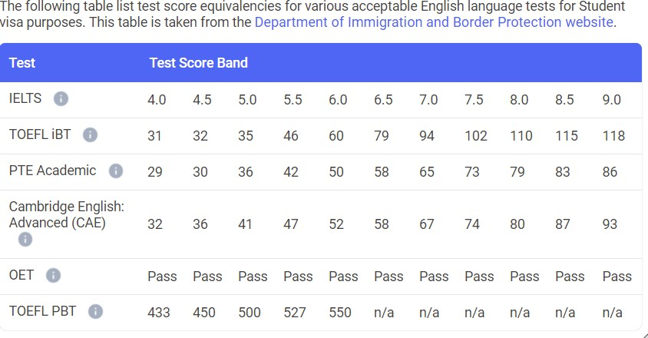
Entry Requirements
English Test
All students will be required to undertake the language, literacy and numeracy testing as part of the Admissions process and where required attend an a face to face interview. You will be required to pass the LLN test at AQF Level 3 or higher.
English Proficiency
English Proficiency results will be accepted from the following providers issued within 2 years of applying for entry to a course with Grayclay. This applies to international students only.
Minimum Age 18 years or over
Pre-requisites
Some courses require students to provide evidence of successful completion of
specific courses and/or registration and/or licensing and’/or be currently working in an occupation directly related to the course. Check the Entry Requirements for your chosen course on our website at https://grayclay.com.au/#
Computer Proficiency
Course materials, lectures and trainers are accessible online. All students must be computer literate and proficient in the use of software and equipment listed within the course prospectus, brochure and course webpage.

